Slide 1
Utility Network SDK
Alpha 12 Overview
November 8, 2016

Slide 2
Overview
This document provides an overview of the utility network SDK
SDK Sections:
Core
Definition
Network Topology
Tracing
Diagrams

Slide 3
Core
UtilityNetwork and FeatureElement

Slide 4
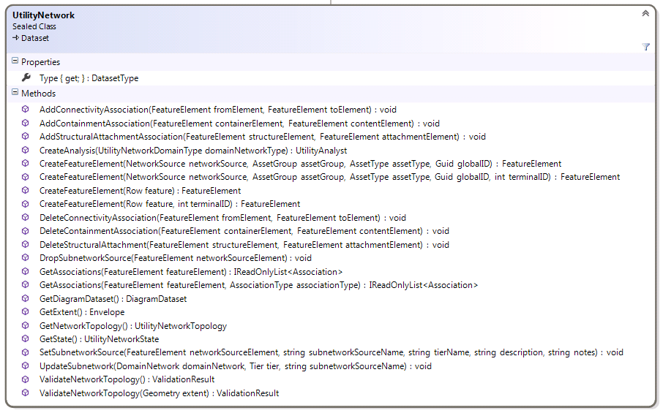
UtilityNetwork
The UtilityNetwork class serves as the core class in the utility network SDK
Use the UtilityNetwork class to:
Create and delete associations
Update subnetworks
Update and query network topology
Get other utility network classes

Slide 6
Obtaining a UtilityNetwork object
UtilityNetwork objects can be obtained by name
Geodatabase.OpenDataset<UtilityNetwork>(string datasetName)
UtilityNetwork objects can be obtained from a Table
Table.IsControllerDatasetSupported() : bool
Table.GetControllerDataset() : IReadOnlyList<Dataset>

Slide 7
UtilityNetwork: Create and Delete Associations
AddConnectivityAssociation(FeatureElement fromElement, FeatureElement toElement) : void
AddContainmentAssociation(FeatureElement containerElement, FeatureElement contentElement) : void
AddContainmentAssociation(FeatureElement containerElement, FeatureElement contentElement, bool isVisibleContent) : void
AddStructuralAttachmentAssociation(FeatureElement structureElement, FeatureElement attachmentElement) : void
DeleteConnectivityAssociation(FeatureElement fromElement, FeatureElement toElement) : void
DeleteContainmentAssociation(FeatureElement containerElement, FeatureElement contentElement) : void
DeleteStructuralAttachmentAssociation(FeatureElement structureElement, FeatureElement attachmentElement) : void
These routines add and delete associations using the FeatureElement class
These routines create dirty areas; they do not update network topology
Calls to these routines must be wrapped in a transaction
Called from Geodatabase.ApplyEdits()

Slide 8
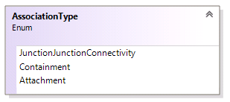
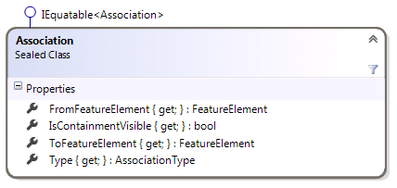
Get Associations
GetAssociations(FeatureElement featureElement, AssociationType type) : IReadOnlyList<Association>
GetAssociations(FeatureElement featureElement) : IReadOnlyList<Association>
AssociationType is defined as follows:
If the AssociationType parameter is missing, associations of all types are returned
The Association return type is defined as follows:

Slide 9
More Information about GetAssociations
GetAssociations returns the contents of the internal associations table.
The routine does not return an accurate or complete picture of network connectivity; features that are connected by geometric coincidence are not returned.
The list returned can contain associations that have not yet been validated and are therefore not yet included in the topological index.
Conversely, it will not return deleted records that still exist in the topological index
However, it is the correct mechanism to use when building an editing tool, as it shows the current edited state of the database

Slide 10
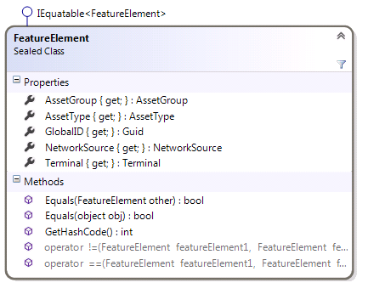
FeatureElement Class
This class represents a Feature inside a utility network, plus a Terminal
FeatureElements can be created using factory methods on UtilityNetwork
CreateFeatureElement(AssetType assetType, Guid globalID, int terminalID) : FeatureElement
CreateFeatureElement(AssetType assetType, Guid gloalID) : FeatureElement
CreateFeatureElement(Row row, int terminalID) : FeatureElement
CreateFeatureElement(Row row) : FeatureElement
FeatureElements can also be obtained from the network topology using UtilityNetworkTopology.GetFeatureElement()
Read-only Properties
NetworkSource : NetworkSource
AssetGroup : AssetGroup
AssetType : AssetType
GlobalID : Guid
Terminal : Terminal

Slide 11
UtilityNetwork: Subnetworks
SetSubnetworkSource(FeatureElement networkSourceElement, string subnetworkSourceName, string tierName, string description, string notes) : void
DropSubnetworkSource(FeatureElement networkSourceElement) : void
These routines add and remove subnetwork sources from the network
These routines create dirty areas; they do not update the network index
Calls to these routines must be wrapped in a transaction
Called from Geodatabase.ApplyEdits()
UpdateSubnetwork(Network domainNetwork, Tier tier, string subnetworkSourceName) : void
Updates the given subnetwork. This is the equivalent of running the Update Subnetwork geoprocessing tool on the specified subnetwork.
More Subnetwork routines will be added to the SDK in a future alpha release.

Slide 12
UtilityNetwork: Validate Network Topology
ValidateNetworkTopology(Geometry extent) : ValidationResult
ValidateNetworkTopology() : ValidationResult
Updates network topology within the provided extent. If the extent parameter is missing or null, the extent of the utility network is used.
Calls to this routine must be wrapped in a transaction
Called from Geodatabase.ApplyEdits()

Slide 13
ValidationResult
This class is used to return information from a call to UtilityNetwork.ValidateTopology().
UpdateLocalTime: DateTime
The DateTime when the ValidateTopology() call took place, converted to the time zone of the ArcGIS Pro client machine.
HasErrors: bool
Returns whether there are any errors in the entire network topology.
NumberOfDirtyAreas: int
Returns the number of dirty areas that were processed in the call to ValidateTopology().
IsFullUpdate: bool
Returns true if the ValidateTopology call was executed on the entire network.

Slide 14
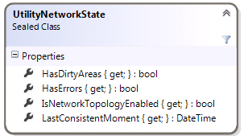
UtilityNetwork: Network Topology Queries
GetExtent() : Envelope
Returns the extent of the feature classes within the network (same as other controller datasets in the product)
GetState() : UtilityNetworkState
Returns the state of the network

Slide 15
UtilityNetworkState
Represents the state of the utility network
HasDirtyAreas : bool
Returns whether the network topology of the utility network contains any dirty areas.
HasErrors : bool
Returns whether the network topology of the utility network has any errors.
IsNetworkTopologyEnabled : bool
Returns whether the network topology of the utility network is enabled.
LastConsistentMoment : DateTime
Returns the DateTime of the last time that the utility network was fully validated.

Slide 16
UtilityNetwork: Get Other Utility Network Classes
The UtilityNetwork object also serves a central access point to several other utility network classes
GetTraceManager() : TraceManager
Covered in the Tracing section of this document
GetDefinition() : UtilityNetworkDefinition
Covered in the Definition section of this document
GetDiagramDataset() : DiagramDataset
Covered in the Diagrams section of this document
GetNetworkTopology() : UtilityNetworkTopology
Covered in the Network Topology section of this document

Slide 17
Definition
UtilityNetworkDefinition and friends

Slide 18
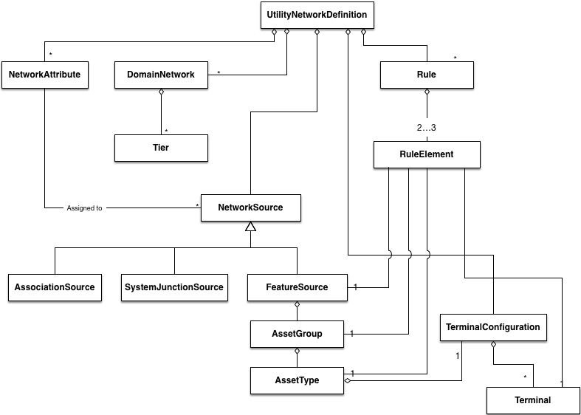

Slide 20
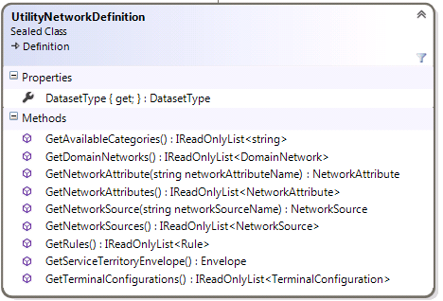
UtilityNetworkDefinition
The UtilityNetworkDefinition class provides information about a utility network.
This includes information about domain networks, network sources, association rules, terminals, and network attributes
The UtilityNetworkDefinition object is obtained through a call to UtilityNetwork.GetDefinition()

Slide 21
UtilityNetworkDefinition: General Routines
DatasetType : DatasetType
Returns the dataset type.
This is identical to the value returned by UtilityNetwork.Type. Both properties are included to conform with the convention established by other dataset types
GetServiceTerritoryEnvelope() : Envelope
Returns the extent of the utility network (i.e., the extent of the service territory + 10%).
Note that this can be slightly different than the value returned by UtilityNetwork.GetExtent()
GetAvailableCategories() : IReadOnlyList<string>
Returns a list of all the categories that have been registered with the utility network.

Slide 23
UtilityNetworkDefinition: Domain Networks
A domain network represents an industry domain
Some examples include electric distribution, electric transmission, gas, and water
UtilityNetworkDefinition.GetDomainNetworks() : IReadOnlyList<DomainNetwork>
Returns a list of domain networks included with this utility network

Slide 24
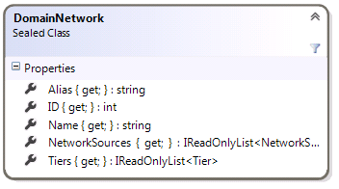
Domain Network
Alias : string
A user-readable name
ID : int
An identifier for the domain network. This identifier is unique within a single utility network
Name : string
The name is prepended to the feature classes in the domain network
NetworkSources : IReadOnlyList<NetworkSource>
The list of network sources for this domain network. Network sources are described later in this document
Tiers : IReadOnlyList<Tier>
Returns the tiers in this domain network. Tiers are described later in this document

Slide 26
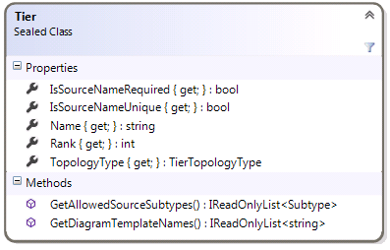
Tiers - 1
Tiers demarcate a logical level within the network
E.g., in an electric distribution network, there may be Subtransmission, MediumVoltage, and LowVoltage tiers
Some networks may only have one tier, such as electric transmission
Tiers are value objects
IsSourceNameRequired : bool
Determines whether subnetwork sources within this tier require a name
IsSourceNameUnique : bool
Determines whether subnetwork sources within this tier require unique names
GetAllowedSourceSubtypes() : IReadOnlyList<Subtype>
Returns a list of subtypes that can be subnetwork sources within this tier
This routine will be changed in a future alpha release

Slide 27
Tiers - 2
GetDiagramTemplateNames() : IReadOnlyList<string>
Returns the default diagram templates for this tier
Name : string
The name of the tier (e.g., “Medium voltage”)
Rank : int
The numeric rank of the tier.
TopologyType : TierTopologyType
The type of subnetworks that are supported
TierTopologyType is an enum with the values Radial, MultifeedRadial and Mesh

Slide 29
Network Sources
A Network Source is a feature class that can serve as sources of information for a utility network . It should not be confused with a subnetwork source.
Network Sources can be obtained with four different routines:
UtilityNetworkDefinition.GetNetworkSource(string networkSourceName) : NetworkSource
UtilityNetworkDefinition.GetNetworkSources() : IReadOnlyList<NetworkSource>
DomainNetwork.NetworkSources : IReadOnlyList<NetworkSource>

Slide 30
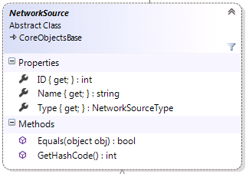
NetworkSource
NetworkSource is the abstract base class for the Network Source class family
ID : int
The numeric ID of the network source
Name : string
The name of the network source. This is the name of the underlying table, not a user-readable name.
Type : NetworkSourceType
The values for the NetworkSourceType enum are as follows: SystemJunction, Boundary, Junction, Edge, Association
NetworkSource objects can be compared with the comparison operator

Slide 31
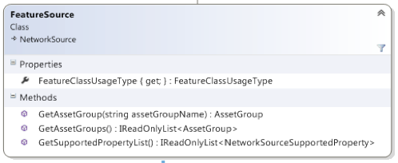
FeatureSource
FeatureSource represents a source that is created from a user feature class
FeatureClassUsageType : FeatureClassUsageType
This property returns how the feature class is used.
Possible values are Device, Junction, Line, Assembly, SubnetLine, StructureJunction, StructureLine, and StructureBoundary.
GetAssetGroup(string assetGroupName) : AssetGroup
GetAssetGroups() : IReadOnlyList<AssetGroup>
Returns one or more AssetGroups (subtypes) for this particular feature class
GetSupportedPropertyList() : IReadOnlyList<NetworkSourceSupportedProperty>
Returns the properties that this network source supports. Possible values are Containment, StructuralAttachments, Categories, Terminals, NetworkAttributes.

Slide 32
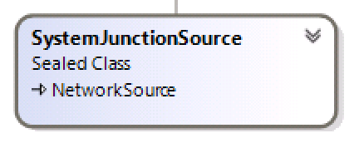
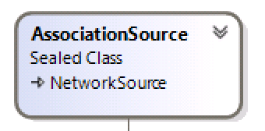
System Sources
SystemJunctionSource
Concrete class that represents system junctions (marker interface)
AssociationSource
Concrete class that represents associations (marker interface)

Slide 34
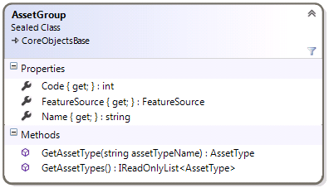
AssetGroup
The AssetGroup class provides information about Asset Groups (subtypes) within the utility network. In the core geodatabase, they are implemented as subtypes.
Code : int
The subtype code
FeatureSource : FeatureSource
The parent FeatureSource
Name : string
The subtype name
GetAssetType(string assetTypeName) : AssetType
GetAssetTypes() : IReadOnlyList<AssetType>
Returns Asset Type definitions

Slide 36
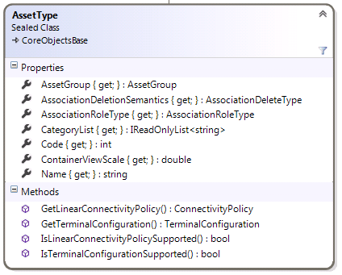
AssetType - 1
Provides information about the definition of an AssetType
AssetGroup : AssetGroup
The parent AssetGroup
Code : int
The code of the AssetType domain
Name: string
The string value of the AssetType domain
IsLinearConnectivityPolicySupported() : bool
Returns whether or not the GetConnectivityPolicy() routine is applicable.
GetLinearConnectivityPolicy() : ConnectivityPolicy
Returns whether connectivity for this asset type can be established at any vertex (AnyVertex) or only at end points (EndVertex)
AssocationDeletionSemantics : AssociationDeleteType
The deletion type for this asset class (Cascade, None, Restricted)

Slide 37
AssetType - 2
ContainerViewScale : double
Returns the default scale of any containers created from this asset type.
If the asset type is not a container, this routine returns 0.0.
AssociationRoleType : AssociationRoleType
Returns whether the asset type can be a Container, Structure, or neither (None).
GetCategoryList() : IReadOnlyList<string>
Returns the categories supported
IsTerminalConfigurationSupported() : bool
Returns whether or not the GetTerminalConfiguration() routine is applicable
GetTerminalConfiguration() : TerminalConfiguration
Returns the TerminalConfiguration for this asset type

Slide 38
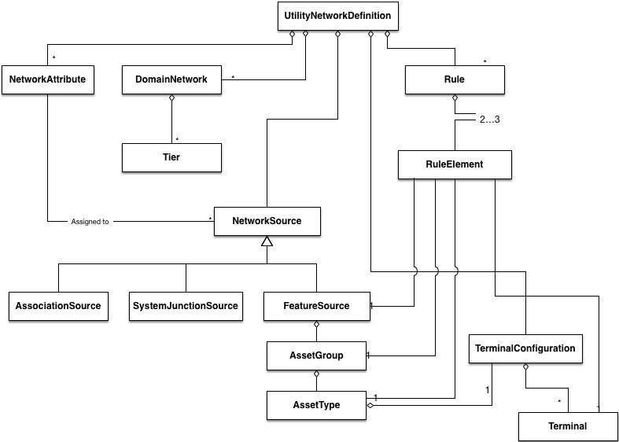

Slide 39
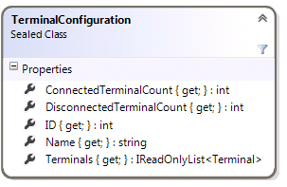
Terminal Configurations
This class will be redesigned in a future alpha release
Terminal configurations are immutable value objects that represent a configuration of terminals associated with 0 or more subtypes.
Terminal configurations can be obtained through two different methods:
UtilityNetworkDefinition.GetTerminalConfigurations() : IReadOnlyList<TerminalConfiguration>
JunctionSource.GetTerminalConfiguration(Subtype subtype) : TerminalConfiguration
ConnectedTerminalCount : int
DisconnectedTerminalCount : int
ID : int
Name : string
A user-readable string that describes the terminal configuration
Terminals : IReadOnlyList<Terminal>

Slide 40
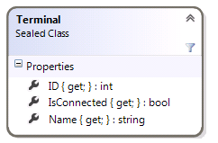
Terminals
This class will be redesigned in a future alpha release
Terminal is an immutable value object representing a single terminal on a junction feature
ID : int
IsConnected : bool
Name : string
A user-readable string

Slide 42
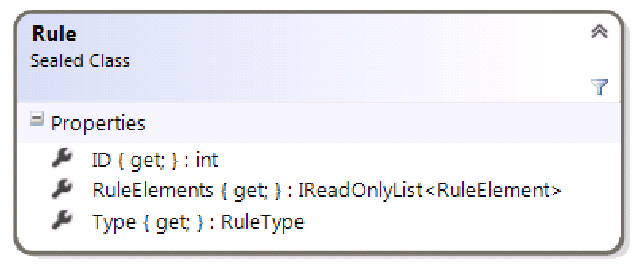
Rule
Describes a rule in the utility network. These define how features in a utility network can be associated with each other through connectivity, containment, and attachment
Rule objects are obtained by calling UtilityNetworkDefinition.GetRules() : IReadOnlyList<Rule>
Type : RuleType
Returns either JunctionJunctionConnectivity, JunctionEdgeConnectivity, Containment, Attachment, or EdgeJunctionEdgeConnectivity telling us what kind of rule it is
ID : int
Returns a numeric ID that can be used to identify the rule
RuleElements : IReadOnlyList<RuleElement>
The elements that make up the rule (see next slide)

Slide 43
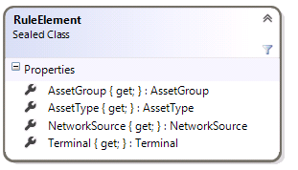
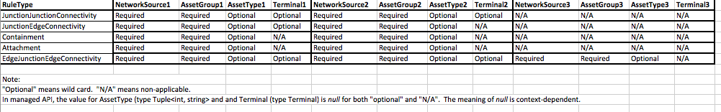
RuleElements
This is a value class that stores information about the elements of a rule.
NetworkSource : NetworkSource
AssetGroup : AssetGroup
AssetType : AssetType
If null, this means that all AssetTypes of this AssetGroup participate in the rule
Terminal : Terminal
The meaning of these parameters depend on the rule type, as illustrated below:

Slide 45
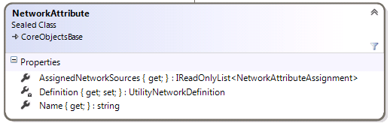
Network Attributes
The NetworkAttribute class represents a network attribute (logically equivalent to a weight in the geometric network)
NetworkAttributes can be obtained by calling UtilityNetworkDefinition.GetNetworkAttributes() : IReadOnlyList<NetworkAttribute>
UtilityNetworkDefinition.GetNetworkAttribute(string networkAttributeName): NetworkAttribute
AssignedNetworkSources : IReadOnlyList<NetworkSourceAssignment>
A list of how this network attribute is assigned to feature sources.
Name : string
The name of the network attribute

Slide 46
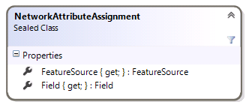
Network Attribute Assignment
The NetworkAttributeAssignment class describes how a NetworkAttribute is assigned to a specific FeatureSource (feature class).
If the same NetworkAttribute is assigned to multiple feature classes, NetworkAttribute.AssignedNetworkSources will return one object for each of these assignments.
FeatureSource : FeatureSource
Field : Field

Slide 47

Network Topology
UtilityNetworkTopology, NetworkElement, NetworkAttribute, NetworkEvaluator, and friends

Slide 48
Important Note about this Section
We are currently evaluating how these routines will work in a services-only environment.
Future versions of the utility network alpha could present a coarser-grained API than the one shown here.
In particular, the API may become more feature-focused rather than network element-focused

Slide 49
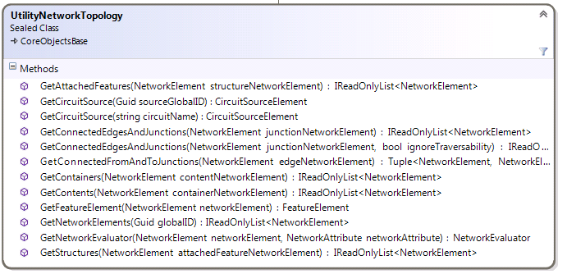
UtilityNetworkTopology
The UtilityNetworkTopology class provides low-level query capabilities against network topology.
The UtilityNetworkTopology object is obtained through a call to UtilityNetwork.GetNetworkTopology().

Slide 50
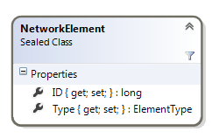
NetworkElement
Utility network topology deals with individual edges and junctions as NetworkElement objects
A single feature can be composed of multiple NetworkElements
Example 1: A MediumVoltage line can consist of multiple edge elements
Example 2: A CircuitBreaker device consists of two junction elements representing the terminals, plus an internal edge in between them
NetworkElement objects are obtained from methods on the UtilityNetworkTopology class
The NetworkElement class implements IEquatable<T>
ID : long
A unique identifier
Type : ElementType
Describes the type of network element. Valid values are None, Junction, or Edge.

Slide 51
UtilityNetworkTopology – Converting Between FeatureElements and NetworkElements
GetFeatureElement(NetworkElement networkElement) : FeatureElement
Returns the FeatureElement corresponding to a given NetworkElement
Terminal of the FeatureElement is null for edge features and junction features without terminals; otherwise the correct Terminal object is returned
GetNetworkElements(Guid globalID) : IReadOnlyList<NetworkElement>
Returns the list of NetworkElements that compose the feature identified by the globalID parameter
Note that there is no routine to convert between a FeatureElement and a NetworkElement
For edges and junctions without terminals, the process is quite simple
IReadOnlyList<NetworkElement> networkElements = networkTopology.GetNetworkElements(featureElement.GlobalID);
For junctions with terminals, you need to perform an additional step of walking the list of network elements returned above and converting them back to FeatureElements. You need to find the FeatureElement from that list with the same terminal ID as your original FeatureElement.

Slide 52
UtilityNetworkTopology – Connectivity
GetConnectedEdgesAndJunctions(NetworkElement junctionNetworkElement) : IReadOnlyList<NetworkElement>
Returns the NetworkElements connected to a junction.
GetConnectedFromAndToJunctions(NetworkElement edgeNetworkElement) : Tuple<NetworkElement, NetworkElement>
Returns the NetworkElements connected to an edge

Slide 53
UtilityNetworkTopology – Containment
GetContainers(NetworkElement contentNetworkElement) : IReadOnlyList<NetworkElement>
Returns the containers that contain the contentNetworkElement
Note that if contentNetworkElement is an edge, it could belong to multiple containers
GetContents(NetworkElement containerNetworkElement) : IReadOnlyList<NetworkElement>
Returns the contents of the container represented by the containerNetworkElement

Slide 54
UtilityNetworkTopology – Structural Attachments
GetAttachedFeatures(NetworkElement structureNetworkElement) : IReadOnlyList<NetworkElement>
Returns a list of network elements attached the the given structureNetworkElement structure
GetStructures(NetworkElement attachedFeatureNetworkElement) : IReadOnlyList<NetworkElement>
Returns the structure that the given attachedFeatureNetworkElement is attached to

Slide 55
UtilityNetworkTopology - CircuitSources
GetCircuitSource(Guid sourceGlobalID) : CircuitSourceElement
GetCircuitSource(string circuitName) : CircuitSourceElement
These routines, as well as the CircuitSourceElement class, are slated for replacement in a future utility network alpha release.

Slide 56
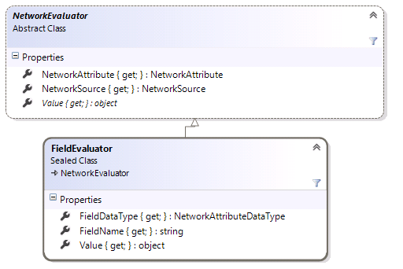
Network Evaluators
Network evaluators are used to provide the value of a network attribute for a given network element
Network evaluators are obtained by calling UtilityNetwork.GetNetwork
GetNetworkEvaluator(NetworkElement networkElement, NetworkAttribute networkAttribute) : NetworkEvaluator

Slide 57
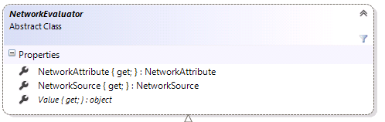
NetworkEvaluator
NetworkAttribute : NetworkAttribute
The NetworkAttribute that the evaluator used to compute its value
NetworkSource : NetworkSource
The NetworkSource used by this evalutor
Value : object
The value of the network attribute for the network element used to construct the evaluator

Slide 58
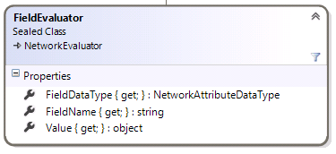
FieldEvaluator
The FieldEvaluator adds two properties to the abstract base class.
FieldDataType : NetworkAttributeDataType
The data type of the field that provides values for the network attribute
FieldName : string
The name of the field that provides values for the network attribute

Slide 59
Tracing

Slide 60
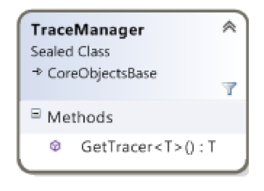
TraceManager class
The TraceManager class provides access to Tracer objects
TraceManager objects are obtained through a call to UtilityNetwork.GetTraceManager()
GetTracer<T>() : T
Returns a Tracer object of the specified type (described on next page)

Slide 61
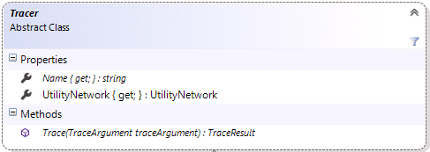
Tracer Abstract Class
Name : string
The name of the Tracer object
UtilityNetwork : UtilityNetwork
A pointer back to the UtilityNetwork core object
Trace(TraceArgument traceArgument) : TraceResult
Perform a trace

Slide 62
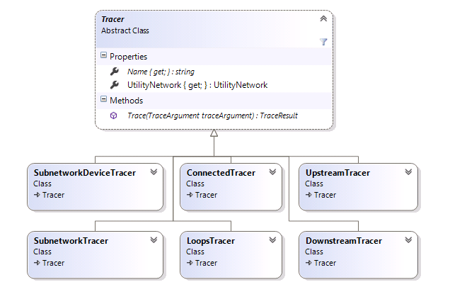
Tracer Concrete Classes

Slide 63
Extending Tracer
Although we expect that most tracing functionality can be built using our configuration framework, there are other cases where clients will want a custom Tracer
Custom Tracers Could Wrap Esri Tracers
For example, a partner might provide a Tracer objects which automatically include a set of NetworkAttribute filters to specify phase.
E.g., AcmeElectricDownstreamTracer
Partners may wish to provide additional pre- or post-processing that the Esri configuration framework doesn’t provide
Custom Tracers Could Be Written By Hand
For example, a partner might make a call to a DMS or other external system to perform an analytic
Custom Tracers Could Be Written Using Low-Level Topology Primitives
UtilityNetworkTopology.GetConnectedEdgesAndJunctions, etc.
Would only perform well on SQLite or after we’ve implemented a client-side network cache

Slide 64
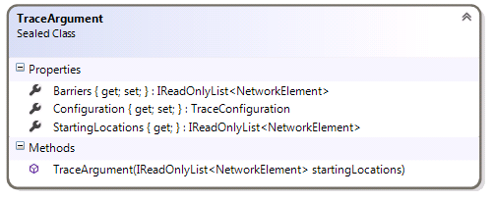
TraceArgument
The TraceArgument class consolidates trace parameters
Different tracers may subclass TraceArgument
Barriers : IReadOnlyList<NetworkElement>
StartingLocations: IReadOnlyList<NetworkElement>
Configuration: TraceConfiguration

Slide 65
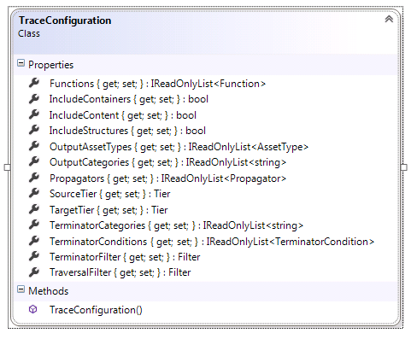
The Trace Configuration object
Encapsulates additional optional parameters for a trace
The properties can be categorized as follows:
Basics
Traversal Filters
Functions
Terminators
Output Filters
Propagators

Slide 66
1 TraceConfiguration - Basics
IncludeContainers: bool
Default is false.
IncludeContent: bool
Default is false.
IncludeStructures: bool
Default is false.
IncludeContainers and IncludeStructures are transitive
i.e., if they are both true, if a container contains a result element, and that container is attached to a structure, the structure is returned even if the result element is not directly attached to the structure
Note: This is not yet implemented in the current alpha software.
IncludeContainers is recursive
i.e., if true, if a result element is inside a nested container, both containers are returned

Slide 67
1 Trace Configuration - Basics
SourceTier : Tier
This property is optional. If not null, the Trace routines will perform an additional check to validate that the starting points and barriers belong to this tier.
TargetTier : Tier
This property is optional. If null, upstream and downstream traces will stop in the current tier (i.e., that devices that delineate the tier boundary). If a TargetTier is specified, the trace will continue upstream or downstream into the specified tier.

Slide 68
2 TraceConfiguration – Traversal Filters
As the Tracer navigates through the network, filters can be applied to allow traversal
If the visited network element meets the criteria of the filter, traversal continues
If the visited network element does not meet the criteria, that element is NOT included in the results
A null traversal filter always permits traversal
Traversal filters are based on comparisons of network attributes
Traversal filters can be combined with boolean And and Or operations to form more complex filters
TraversalFilter : Filter

Slide 69
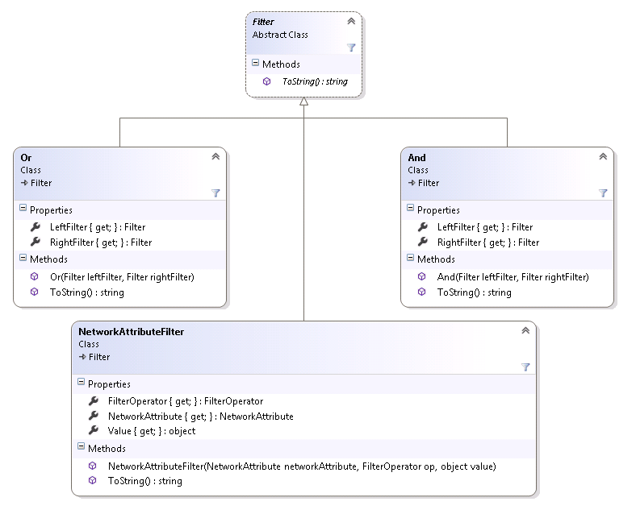
Traversal Filter Class Hierarchy

Slide 70
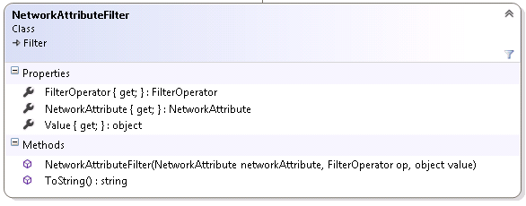
NetworkAttributeFilter
NetworkAttributeFilter(NetworkAttribute networkAttribute, FilterOperator op, object Value)
Creates a network attribute filter. The filter allows continued traversal depending on the result of the expression
FilterOperator : FilterOperator
Returns the boolean operator used to defined the filter. Possible values are Equal, NotEqual, BitwiseAnd, GreaterThan, GreaterThanEqual, LessThan, LessthanEqual, and BitwiseAny.
NetworkAttribute : NetworkAttribute
The network attribute to test
Value : object
The value to test against

Slide 71
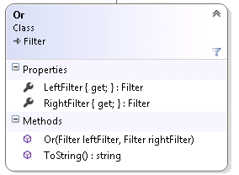
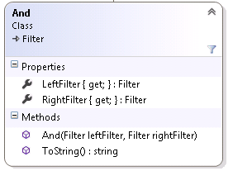
Combination Filters
The Or and And classes are provided to allow chaining of logical expressions
Or(Filter leftOperand, Filter rightOperand)
And(Filter leftOperand, Filter rightOperand)

Slide 72
3 Trace Configuration - Functions
The caller can specify a collection of Functions for a trace
These functions are evaluated at each applicable network element
The meaning of applicable varies per trace
For an upstream trace, the functions are evaluated for each upstream element
For a subnetwork trace, the functions are evaluated for each element in the subnetwork
For a subnetwork sources trace, the functions are evaluated for each subnetwork source element
Etc.
At the conclusion of the trace, function results can be obtained globally and for each applicable element
Not yet implemented
Described later in this document
Functions : IReadOnlyList<Function>

Slide 73
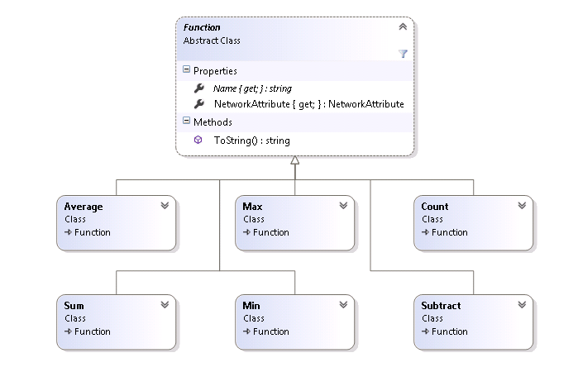
Function Class Hierarchy
Eventually, custom functions may be supported

Slide 74
Meaning of Trace Functions
Function | Meaning
Sum | Sums up the value of the network attribute on each applicable element
Subtract | Takes the network attribute value from the starting point as the base number, and then subtracts the value of the network attribute on each applicable element
Average | Averages the value of the network attribute on each applicable element
Count | Counts the number of applicable elements
Min | The minimum value of the network attribute on each applicable element
Max | The maximum value of the network attribute on each applicable element

Slide 75
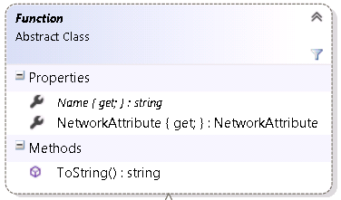
Function class
NetworkAttribute : NetworkAttribute
The NetworkAttribute used as an input to the function.
Name: string
The name of the function.

Slide 76
4 Trace Configuration - Terminators
Terminators provide a way to terminate further traversal when visiting a network element
Teminators take three different forms
Terminator Categories
Terminator Conditions
Terminator Filters
If ANY category or condition or filter is satisfied, further traversal is terminated
That particular network element IS included in the trace results
TerminatorConditions: IReadOnlyList<TerminatorCondition>
Traversal stops if the TerminatorCondition evaluates to true
TerminatorConditions are based on comparing a function result to a specified value
TeminatorConditions are always combined using Or. I.e., if ANY TerminatorCondition returns true, traversal is terminated

Slide 77
Terminator Categories
TerminatorCategories : IReadOnlyList<string>
Traversal stops if the network element includes any Category in this list

Slide 78
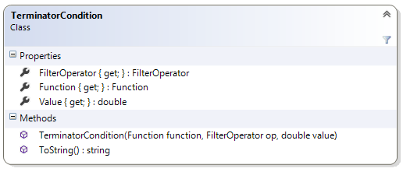
TerminatorCondition
TerminatorConditions: IReadOnlyList<TerminatorCondition>
Traversal stops if the TerminatorCondition evaluates to true
TerminatorConditions are based on comparing a function result to a specified value
TeminatorConditions are always combined using Or. I.e., if ANY TerminatorCondition returns true, traversal is terminated
TerminatorCondition(Function function, FilterOperator op, double Value)
Remember that a Function references a NetworkAttribute and a function that is applied to it (Min, Max, Count, etc.)
The value of the Function for the given network element is compared against the Value parameter using the provided FilterOperator.
78

Slide 79
Terminator Filter
TerminatorFilter : Filter
TerminatorFilters use the same Filter type as a Traversal Filter
TerminatorFilters are NOT the same as negating a Traversal Filter
For Traversal Filters…
If the visited element does not meet the filter criterial, that element is not included in the trace results.
For Terminator Filters...
If the visited element meets the filter criteria, that element is included in the trace results.
In both cases, further traversal is halted.

Slide 80
5 Trace Configuration – Output Filtering
The Trace Configuration object provides two different ways to filter the results of a trace
Output Filtering takes two different forms
Output Categories
Output Asset Types
If ANY category or asset type is satisfied, the element is included in the result set
OutputCategories : IReadOnlyList<string>
The network element is included in the result set if it includes any Category in this list
OutputAssetTypes: IReadOnlyList<AssetType>
The network element is included in the result set if it references a feature that is any AssetType in this list

Slide 81
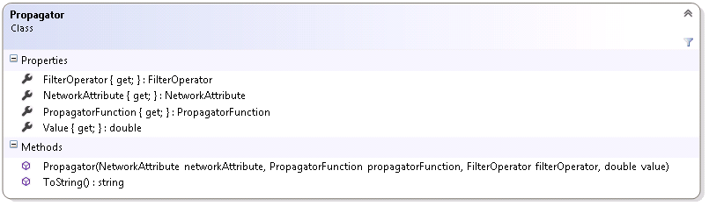
6 Trace Configuration - Propagators
Propagators allow a subset of NetworkAttribute values to propagate through a trace
The canonical example is phase propagation- open devices along the network will restrict some phases from continuing along the trace
Propagators : IReadOnlyList<Propagator>

Slide 82
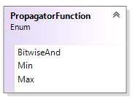
Propagator
A propagator defines the propagation of a network attribute along a traversal, as well as provide a filter to stop traversal.
Propagators are only applicable to subnetwork-based traces (subnetwork, subnetworksource, upstream, downstream)
NetworkAttribute : NetworkAttribute
PropagatorFunction : PropagatorFunction
Operators may be specified that control how the attribute is propagated downstream from a source
For attributes that correspond to numeric values, a min or max operator may be specified
For attributes represented as bitsets, bit-wise set operators may be specified
FilterOperator : FilterOperator
Value: double
The FilterOperator and Value provide a means to stop traversal based on a propagated network attribute.

Slide 83
How Propagators Work
Propagator values are computed as a pre-process step before the main trace takes place
Starting at each source, the propagator uses its PropagatorFunction and NetworkAttribute to calculate a value at each network element
This pre-process traversal covers the extent of a subnetwork
During the trace itself, Propagator filters are tested at the same time as Traversal filters
Traversal filters work on Network Attributes and continue traversal if true
Propagator filters work on propagated values and stop traversal if false
Propagated values are returned with trace results
TraceResult.GetPropagatedValue()
TraceResult.GetAllPropagatedValues()

Slide 84
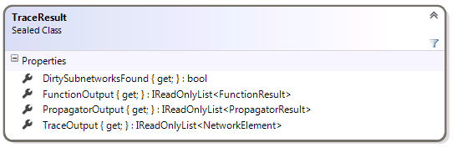
TraceResult -1
The TraceResult class encapsulates all the information that is returned from a trace operation
TraceOutput : IReadOnlyList<NetworkElement>
The actual network elements that are returned in the trace results
DirtySubnetworksFound : bool
Returns whether any dirty subnetworks were encountered during the network traversal.
FunctionOutput : IReadOnlyList<FunctionResult>
The output from all of the Functions included with the trace
PropagatorOutput : IReadOnlyList<PropagatorResult>
The output from the propagator functions

Slide 85
TraceResult - 2
FunctionOutputCore : IReadOnlyList<FunctionResult>
PropagatorOutputCore : IReadOnlyList<PropagatorResult>
TraceOutputCore : IReadOnly<NetworkElement>
These protected properties are provided for partners who wish to extend the TraceResult class.

Slide 86
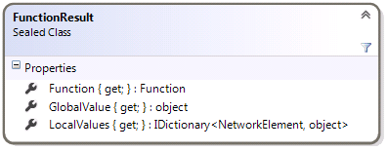
FunctionResult
One FunctionResult object is returned for every Function passed into the TraceConfiguration
Function : Function
Returns the input Function
GlobalValue : object
This routine returns the global function result- i.e., the result of applying the function to all of the network elements traversed.
LocalValues : IDictionary<NetworkElement, object>
Returns the result of the function at each network element
This functionality is not yet implemented

Slide 87
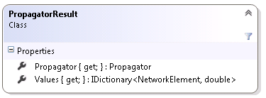
PropagatorResult
One PropagatorResult object is returned for every Propagator passed into the TraceConfiguration
Propagator : Propagator
Returns the input Propagator
Values : IDictionary<NetworkElement, double>
Returns the propagated value at each network element

Slide 88
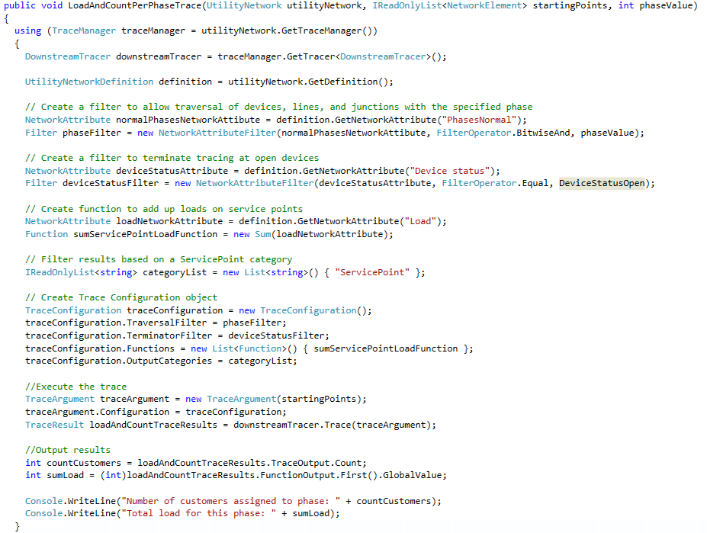

Slide 89
public void LoadAndCountPerPhaseTrace(UtilityNetwork utilityNetwork, IReadOnlyList<NetworkElement> startingPoints, int phaseValue)
{
using (TraceManager traceManager = utilityNetwork.GetTraceManager())
{
DownstreamTracer downstreamTracer = traceManager.GetTracer<DownstreamTracer>();
UtilityNetworkDefinition definition = utilityNetwork.GetDefinition();
// Create a filter to allow traversal of devices, lines, and junctions with the specified phase
NetworkAttribute normalPhasesNetworkAttibute = definition.GetNetworkAttribute("PhasesNormal");
Filter phaseFilter = new NetworkAttributeFilter(normalPhasesNetworkAttibute, FilterOperator.BitwiseAnd, phaseValue);
// Create a filter to terminate tracing at open devices
NetworkAttribute deviceStatusAttribute = definition.GetNetworkAttribute("Device status");
Filter deviceStatusFilter = new NetworkAttributeFilter(deviceStatusAttribute, FilterOperator.Equal, DeviceStatusOpen);
// Create function to add up loads on service points
NetworkAttribute loadNetworkAttribute = definition.GetNetworkAttribute("Load");
Function sumServicePointLoadFunction = new Sum(loadNetworkAttribute);
// Filter results based on a ServicePoint category
IReadOnlyList<string> categoryList = new List<string>() { "ServicePoint" };
// Create Trace Configuration object
TraceConfiguration traceConfiguration = new TraceConfiguration();
traceConfiguration.TraversalFilter = phaseFilter;
traceConfiguration.TerminatorFilter = deviceStatusFilter;
traceConfiguration.Functions = new List<Function>() { sumServicePointLoadFunction };
traceConfiguration.OutputCategories = categoryList;
//Execute the trace
TraceArgument traceArgument = new TraceArgument(startingPoints);
traceArgument.Configuration = traceConfiguration;
TraceResult loadAndCountTraceResults = downstreamTracer.Trace(traceArgument);
//Output results
int countCustomers = loadAndCountTraceResults.TraceOutput.Count;
int sumLoad = (int)loadAndCountTraceResults.FunctionOutput.First().GlobalValue;
Console.WriteLine("Number of customers assigned to phase: " + countCustomers);
Console.WriteLine("Total load for this phase: " + sumLoad);
}
}
Unformatted text provided to allow copy/paste

Slide 90
Network Diagrams

Slide 91
Network Diagrams SDK Introduction
Provides access to the Network Diagrams framework allowing developers to manage network diagrams.
SDK functions to allow:
Retrieving existing diagram templates
Creating, storing, retrieving and deleting network diagrams
Updating, overwriting, and appending network diagrams
Coding custom layout on a network diagram
The SDK does not provide functionality to
Create or configure diagram templates
Apply Network Diagram core algorithm layouts on your network diagram
These tasks can be accomplished with Python or by calling geoprocessing tools directly from C#
Geoprocessing.ExecuteToolAsync

Slide 92
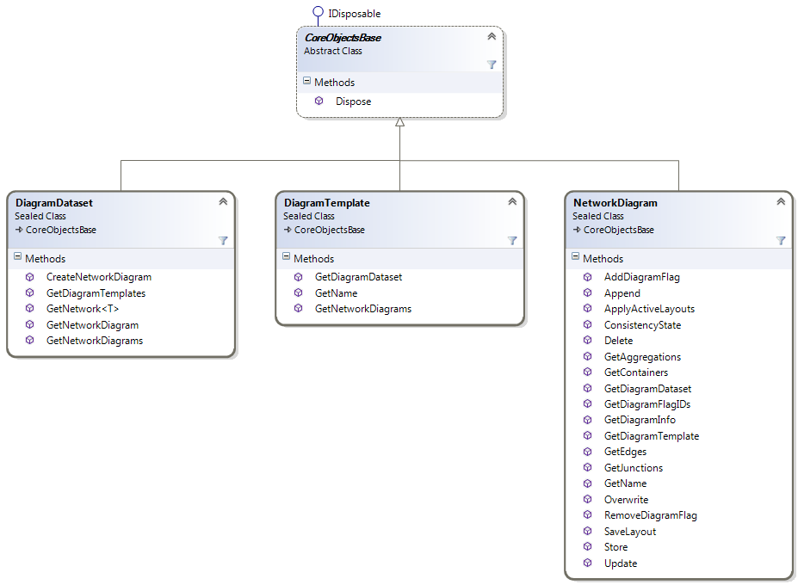
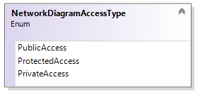
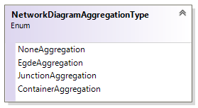
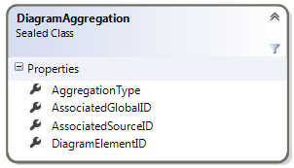




Network Diagrams SDK Introduction

Slide 93

DiagramDataset class
The DiagramDataset class serves as the core class in the Network Diagrams SDK
It is obtained using UtilityNetwork.GetDiagramDataset
Use the DiagramDataset class to:
Create network diagrams
Retrieve diagram templates
Retrieve network diagrams
Retrieve the related utility network

Slide 94
DiagramDataset: Create Network Diagram
CreateNetworkDiagram(DiagramTemplate diagramTemplate, IReadOnlyList<Guid> globalIDs) : NetworkDiagram
This routine creates a temporary network diagram from a set of utility network feature GlobalIDs.
This routine is a transactional operation; that is, calls to it must be wrapped in a transaction
Called from Geodatabase.ApplyEdits()

Slide 95
DiagramDataset: Retrieve Network Diagram(s)
GetNetworkDiagram(string name): NetworkDiagram
GetNetworkDiagrams() : IReadOnlyList<NetworkDiagram>
You can retrieve a particular diagram stored in the diagram dataset using its name.
You can also get the list of all the diagrams stored in the diagram dataset

Slide 96
DiagramDataset: Retrieve Diagram Templates
GetDiagramTemplates() : IReadOnlyList<DiagramTemplate>
This routine allows you to retrieve all the diagram templates related to a utility network

Slide 97

DiagramTemplate Class
The list of the Diagram Templates related to a utility network can be obtained from the diagram dataset using DiagramDataset.GetDiagramTemplates
Methods
GetNetworkDiagrams() : IReadOnlyList<NetworkDiagram>
GetDiagramDataset() : DiagramDataset
GetName() : string

Slide 98
NetworkDiagram Class
This class represents a diagram generated from a portion of the utility network
New network diagrams can be created using a factory method on the diagram dataset
DiagramDataset.CreateNetworkDiagram(DiagramTemplate diagramTemplate, IReadOnlyList<Guid> globalIDs) : NetworkDiagram
Network diagrams that already exist in the diagram dataset can be retrieved
Directly from the diagram dataset
DiagramDataset.GetNetworkDiagrams() : IReadOnlyList<NetworkDiagram>
DiagramDataset.GetNetworkDiagram(string name): NetworkDiagram
From the diagram template they are based on
DiagramTemplate.GetNetworkDiagrams() : IReadOnlyList<NetworkDiagram>

Slide 99

NetworkDiagram Class

Slide 100
NetworkDiagram: Retrieve diagram features
GetJunctions(): IReadOnlyList<DiagramJunction>
GetEdges(): IReadOnlyList<DiagramEdge>
GetContainers(): IReadOnlyList<DiagramContainer>
GetAggregations(): IReadOnlyList<DiagramAggregation>
These routines retrieve the diagram features
Diagram Junctions, Diagram Edges and Diagram Containers are diagram features represented in the diagram
Diagram aggregations list the utility network features that are reduced or collapsed in the diagram

Slide 101
NetworkDiagram: Lay out the diagram content
SaveLayout(IEnumerable<DiagramJunction> junctions, IEnumerable<DiagramEdge> edges, IEnumerable<DiagramContainer> containers) : void
ApplyActiveLayout() : void
Use the SaveLayout to save any custom layout you may have coded by editing the diagram junctions, edges and containers geometry field (Shape)
The ApplyActiveLayout routine applies the list of the layout algorithms currently configured on the template the input network diagram layer is based on.

Slide 102

NetworkDiagram: Manage flags on network diagrams
GetDiagramFlagIDs(NetworkDiagramFlagType flagType) : IReadOnlyList<int>
AddDiagramFlag(NetworkDiagramFlagType flagType, int diagramElementID) : void
RemoveDiagramFlag(NetworkDiagramFlagType flagType, int diagramElementID) : void
The GetDiagramFlagIDs routine retrieves all of the diagram element IDs that are flagged as root or end junctions (depending on the specified flagType).
The AddDiagramFlag and RemoveDiagramFlag routines flags or un-flags a particular diagram element.
The AddDiagramFlag and RemoveDiagramFlag routines are transactional operations; that is, their calls must be wrapped in a transaction
Called from Geodatabase.ApplyEdits()
NOTE: Root and End Junctions are specific junctions recognized by certain algorithm layouts that process the resulting diagram layout accordingly

Slide 103
NetworkDiagram: Update diagram content
Update(): void
Updating a diagram synchronizes a diagram based on the latest network topology- it incorporates any changes that were made to the features since the last update.
The subnetwork ‘system’ diagrams cannot be updated using this routine. These diagrams are updated by calling UtilityNetwork.UpdateSubnetwork
The Update routine is a transactional operation; that is, its calls must be wrapped in a transaction
Called from Geodatabase.ApplyEdits()

Slide 104
NetworkDiagram: Append features to a diagram
Append(IReadOnlyList<Guid> globalIDs) : void
Appending features to a network diagram allows you to add any network features you missed at its generation or that didn't exist at the time the diagram was generated.
No features can be appended to any subnetwork ‘system’ diagrams using this routine. These diagrams are managed by calling UtilityNetwork.UpdateSubnetwork().
These routines are transactional operations; that is, their calls must be wrapped in a transaction
Called from Geodatabase.ApplyEdits()

Slide 105
NetworkDiagram: Overwrite diagram content
Overwrite(IReadOnlyList<Guid> globalIDs) : void
Overwriting a network diagram is a complete rebuilding of the network diagram content from the provided list of features.
The subnetwork ‘system’ diagrams cannot be overwritten using this routine. These diagrams are managed by calling UtilityNetwork.UpdateSubnetwork().
These routines are transactional operations; that is, their calls must be wrapped in a transaction
Called from Geodatabase.ApplyEdits()

Slide 106


NetworkDiagram: Accessing diagram properties
GetName() : string
GetDiagramDataset() : DiagramDataset
GetDiagramTemplate() : DiagramTemplate
ConsistencyState(): NetworkDiagramConsistencyState
GetDiagramInfo(): NetworkDiagramInfo
Those routines allow access to diagram properties
The diagram name,
Its diagram dataset,
The template it is based on,
The diagram consistency state,
All info related to the network diagram, NetworkDiagramInfo—for example, whether it is stored or not, its access level, its tags, when and by whom it has been created/last updated, its extent, etc.

Slide 107
NetworkDiagram: Delete and store
Store(string name, NetworkDiagramAccessType accessType, string tag) : void
Delete() : void
The Store routine persists a temporary network diagram in the database. The diagram name, access level, and tags which are specified at the storing can be altered afterwards using the Set Diagram Properties GP tool.
The Delete routine cannot process subnetwork ‘system’ diagrams.
These routines are transactional operations; that is, their calls must be wrapped in a transaction
Called from Geodatabase.ApplyEdits()

Slide 108

NetworkDiagramInfo class
All the info related to a network diagram can be obtained using NetworkDiagram.GetDiagramInfo(): NetworkDiagramInfo
The NetworkDiagramInfo class provides a set of read-only properties which allow you to know:
the access level of the network diagram, Access
the internal margin of its container polygon, ContainerMargin
whether it is stored or not, IsStored
whether it is a subnetwork ‘system’ diagram or not, IsSystem
its tags, Tag
when and by whom it has been created/last updated, CreationDate, Creator, LastUpdateDate , LastUpdateBy
its extents, DiagramExtent, NetworkExtent.
NOTE: The DiagramExtent is the extent of the diagram itself. The NetworkExtent is the extent formed by the set of utility network features that participated in the diagram building whether those features are represented in the diagram or not.

Slide 109

DiagramJunction, DiagramEdge and DiagramContainer classes
A network diagram consists in a set of diagram elements which are either junctions, edges, or containers.
The three DiagramJunction, DiagramEdge and DiagramContainer classes derive from the same class, DiagramElement, which is a value class that stores information common to all diagram elements:
AssociatedGlobalID : Guid
AssociatedSourceID() : int
ContainerID() : int
ID(): int
Those read-only properties retrieve the utility network feature/utility network element the diagram element is associated with

Slide 110

DiagramJunction, DiagramEdge and DiagramContainer classes

Slide 111
DiagramJunction, DiagramEdge and DiagramContainer classes
The set of DiagramJunction, DiagramEdge and DiagramContainer that compose a diagram are obtained calling NetworkDiagram.GetJunctions, NetworkDiagram.GetEdges, and NetworkDiagram.GetContainers
The DiagramJunction, DiagramEdge and DiagramContainer are classes that provide access to element geometry, Shape , which are read-write properties
The DiagramEdge class also provide topology information, FromID and ToID, which are read-only properties.

Slide 112


DiagramAggregation class
The DiagramAggregation class is a value class that stores aggregation information related to an utility network feature which is not represented in the diagram since it is aggregated under another diagram element; that is, it is reduced or collapsed in the diagram:
AssociatedGlobalID : GUID
AssociatedSourceID() : int
DiagramElementID() : int
Those read-only properties retrieve the aggregated utility network feature and the ID of the diagram element under which it has been reduced or collapsed.
The set of DiagramAggregations related to a diagram are obtained by calling NetworkDiagram.GetAggregations

Slide 113
DiagramAggregation class
There are 4 types of aggregations—JunctionAggregation, EdgeAggregation, ContainerAggregation, and NoneAggregation:
JunctionAggregation—for utility network features aggregated under a diagram junction. This diagram junction may correspond to:
An utility network “container” point or polygon represented as a point in the diagram; this diagram point is related to a set of utility network “content” features that have been collapsed in the network diagram.
A utility network junction point represented as a point in the diagram; this diagram point is related to a set of utility network features that have been reduced in the network diagram.
EdgeAggregation—for utility network features aggregated under a diagram edge. This diagram edge may correspond to:
An utility network “container” line represented as an edge in the diagram; this diagram edge is related to a set of utility network “content” features that have been collapsed in the network diagram.
A reduction edge diagram; this diagram edge is related to a set of utility network features that have been reduced in the network diagram.

Slide 114
DiagramAggregation class
There are 4 types of aggregations—JunctionAggregation, EdgeAggregation, ContainerAggregation, and NoneAggregation:
ContainerAggregation—for utility network features aggregated under a diagram polygon. This diagram polygon may correspond to:
An utility network “container” point or polygon represented as a polygon in the diagram; this diagram polygon is related to a set of utility network “content” features that have been collapsed in the network diagram.
NoneAggregation—for utility network features aggregated in the diagram under no diagram element
For example, unconnected system junctions are systematically reduced to nothing when running a Reduce Junction rule that processes unconnected junctions. In the same way, depending on the Reduce Junction rule settings, certain disconnected portions of the utility network may be reduced to nothing in the resulting diagram

